Slide 1
Marketing Planning and Execution
Oncology
Process Overview and Maps
October 2007

Slide 2
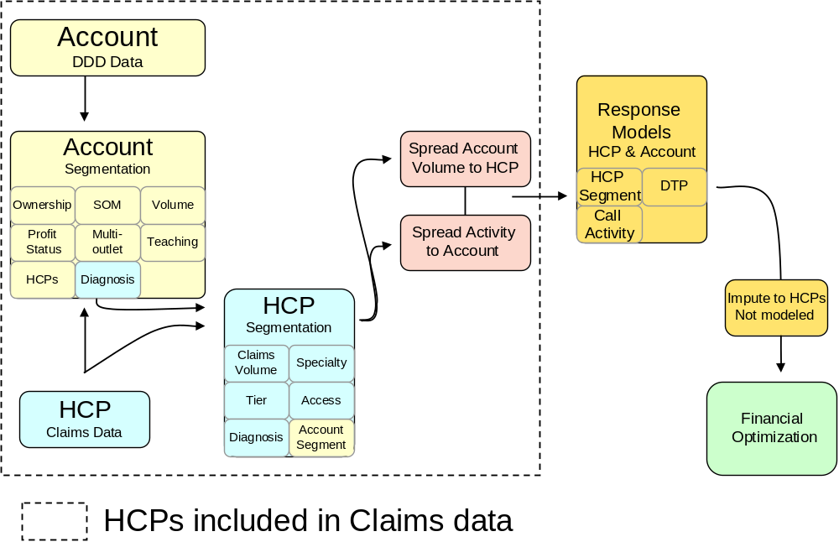
Oncology MP&E Process Overview
Data Collection and Hygiene
Data Integration
Segment Accounts
Projections
  Segment HCPs
  Project $DDD to HCPs
  Project Activity
Identify “Usable” MDs based on claims data
Project Claims volume across MDs based on Tier
Spread DDD volume based on actual and projected claims data for affiliated MDs

Slide 3
Oncology MP&E Process Flow
Account
IMS
Account
Segmentation
Spread HCP
Claims Activity
to Account
Account
Response
Models(?)
Financial
Optimization
HCP
Claims Data
Sales Activity
DTP
HCP
Segmentation
HCP
Response
Models
Impute to HCPs
Not modeled
Just as segments help guide understanding of customer motivation, they are used here to profile response behavior
All available marketing and product usage at the account and MD level is used to help Brand Teams put Marketing $ where it matters:
  Call Plan
  Channel selection
  MD Targets

Slide 4
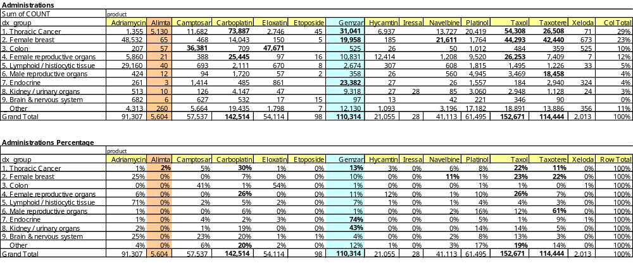
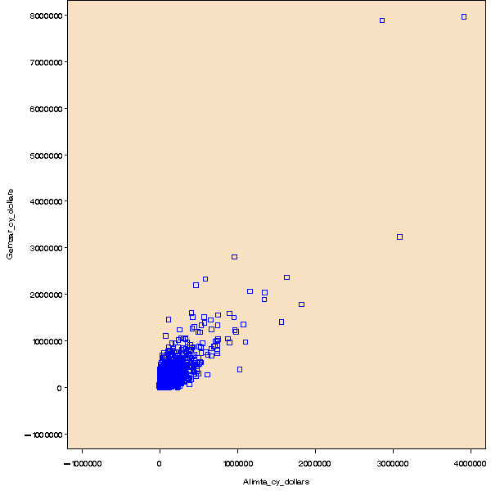
Oncology Market Space
Alimta Clearly focused on Respiratory
Gemzar spread across Indication
However, Alimta/Gemzar $ are highly correlated (>80%) at the account level

Slide 5
Data Collection and Hygiene
IMS Data
  Account and MD affiliation data
  Group Practice, GPO, $DDD
  Account type, beds, Independence etc.
SDI Claims Data
  Procedure / Drug name (Px) and Diagnosis (Dx)
  Preliminary hygiene and projections
Intervention Data
  Details
  Program attendees
  Direct Mail
  Alignment and Tier information

Slide 6
Account coverage by claims data is ~32 %
Of the 4,883 accounts writing Gemzar, 1,577 (32%) were in the claims data with thoracic or pancreas claims.
lungpanc | Gemzar |  | Total
 | 0 | 1
0 | 320 6.55 10.00 75.29 | 2881 59.00 90.00 64.63 | 3201 65.55
1 | 105 2.15 6.24 24.71 | 1577 32.30 93.76 35.37 | 1682 34.45
Total | 425 8.70 | 4458 91.30 | 4883 100.00

Slide 7
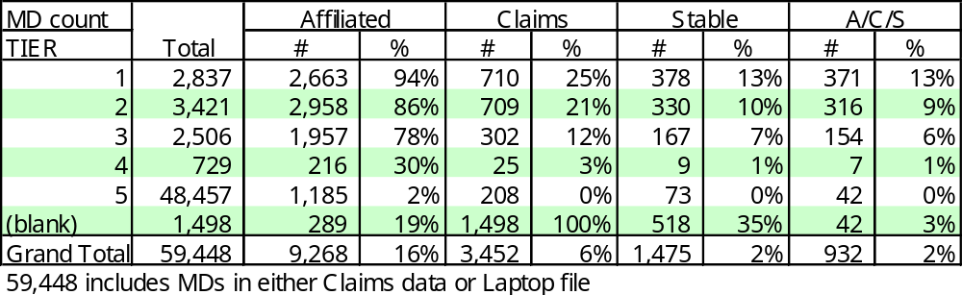
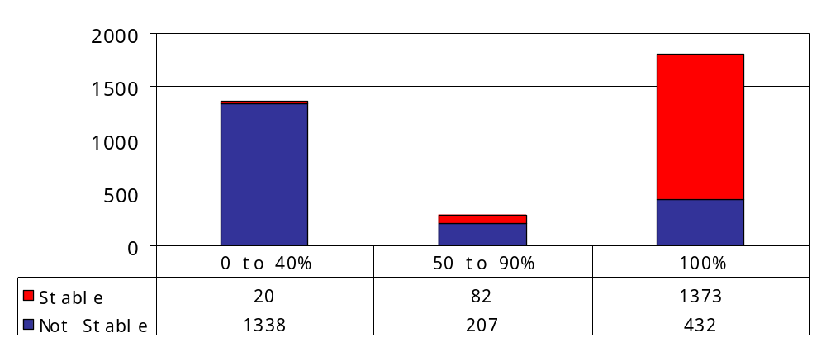
IMS Affiliation and SDI Claims:
Data Quality Metrics by Laptop Tier
Affiliation: Over 86% of tier 1 and 2 HCPs are affiliated with an account
Claims: Over 21% of Tier 1 and 2 MDs in SDI claims data
Stable: 10% of these MDs are stable (50% of the claims data) → they have a large proportion of their administrations captured in the claims data, or have been consistent over time
New Targets? 1,498 HCPs from the Claims Data that were not on the Laptop had an average of 147 administrations, putting them well below Tiers 1 and 2 as a group, however…
Administration: One procedure involving chemotherapy treatment
HCP Claims Data Robustness:
Stability by Percent Capture
Most HCPs fall into one of two groups:
Stable/High Proportion of their claims captured.
Unstable/low proportion of their claims captured
This suggests little gain from projection.

Slide 8
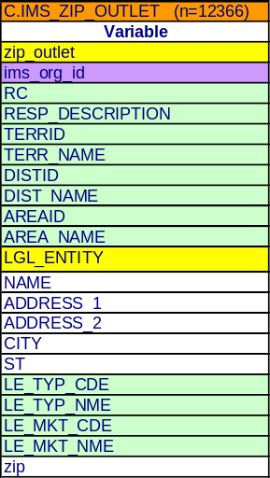
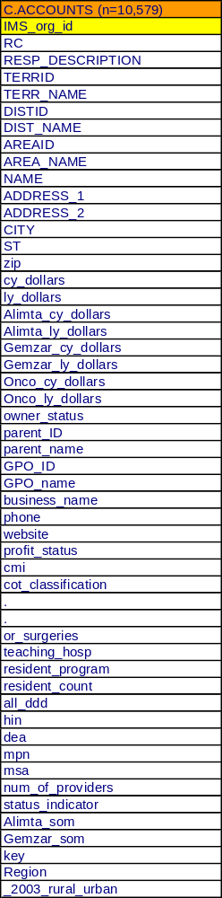
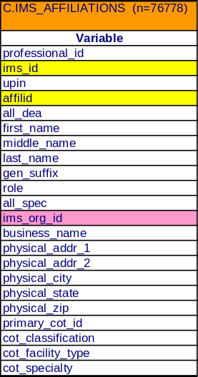
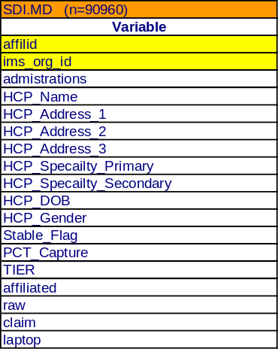
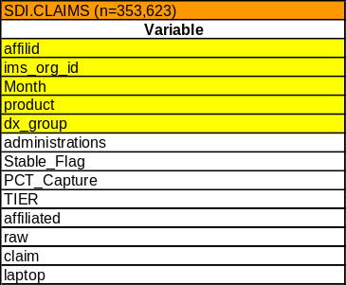
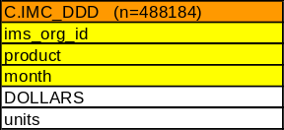
Oncology Data Mart

Slide 9
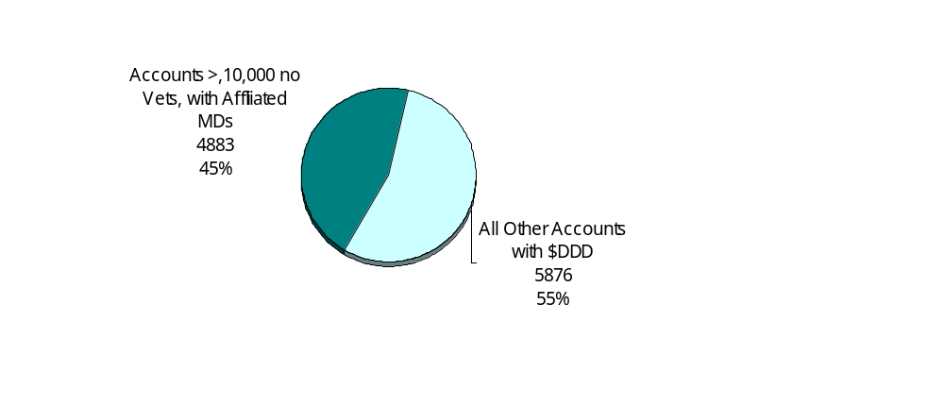
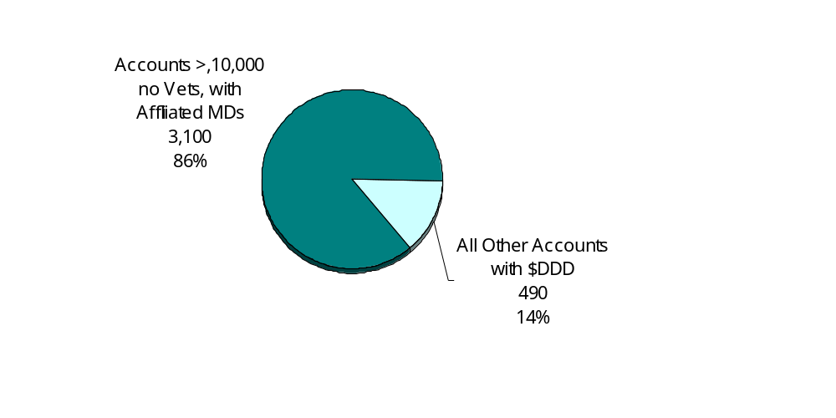
Accounts Segmentation
Accounts Selected
Accounts Selected
  Greater than $10K annual spend on Oncology products
  Affiliated MDs
  No Vet clinics
→ 45% of the Accounts were responsible for 86% of the Oncology Market $
Account $DDD

Slide 10
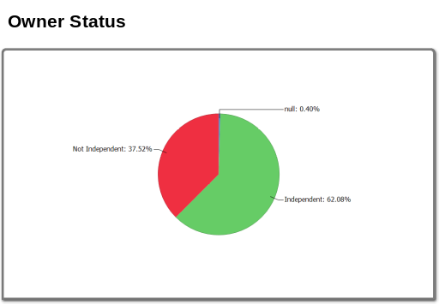
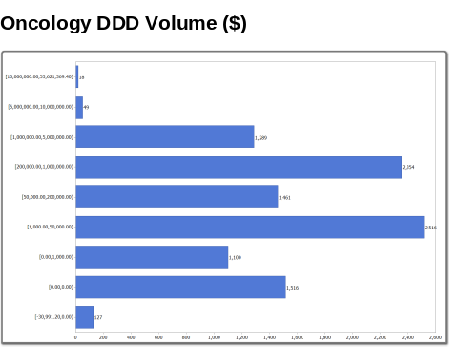
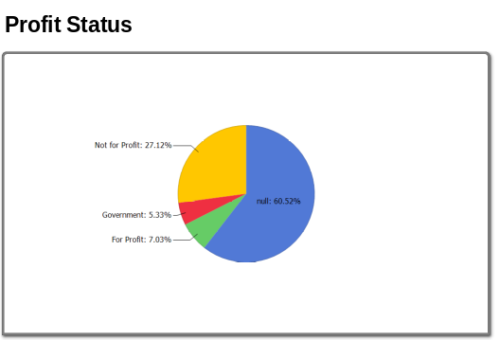
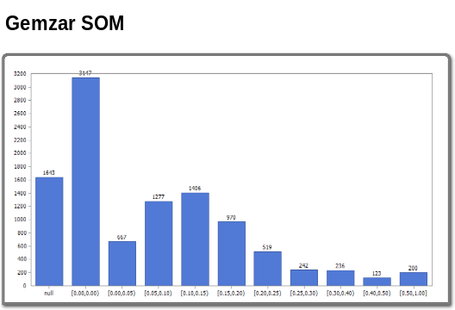
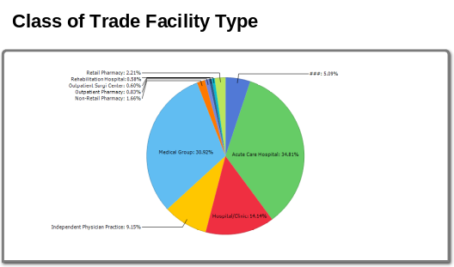
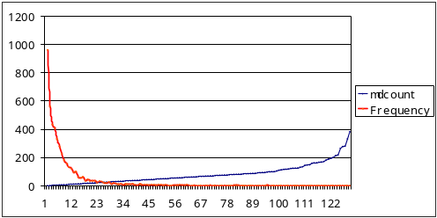
Segmentation Variables
Variable Selection
  Owner Status
  Profit Status (Academic)
  Class of Trade Facility Type
    Hospital/Outpatient/other
  Oncology Volume
  Gemzar SOM
  Alimta Som
  Urban Rural
  Region
  Theraputic Focus
Account Selection
  Called on Accounts only? NO
Hygiene
  Outlier correction
  Standardization
  Factor
Hierarchical Cluster

Slide 11
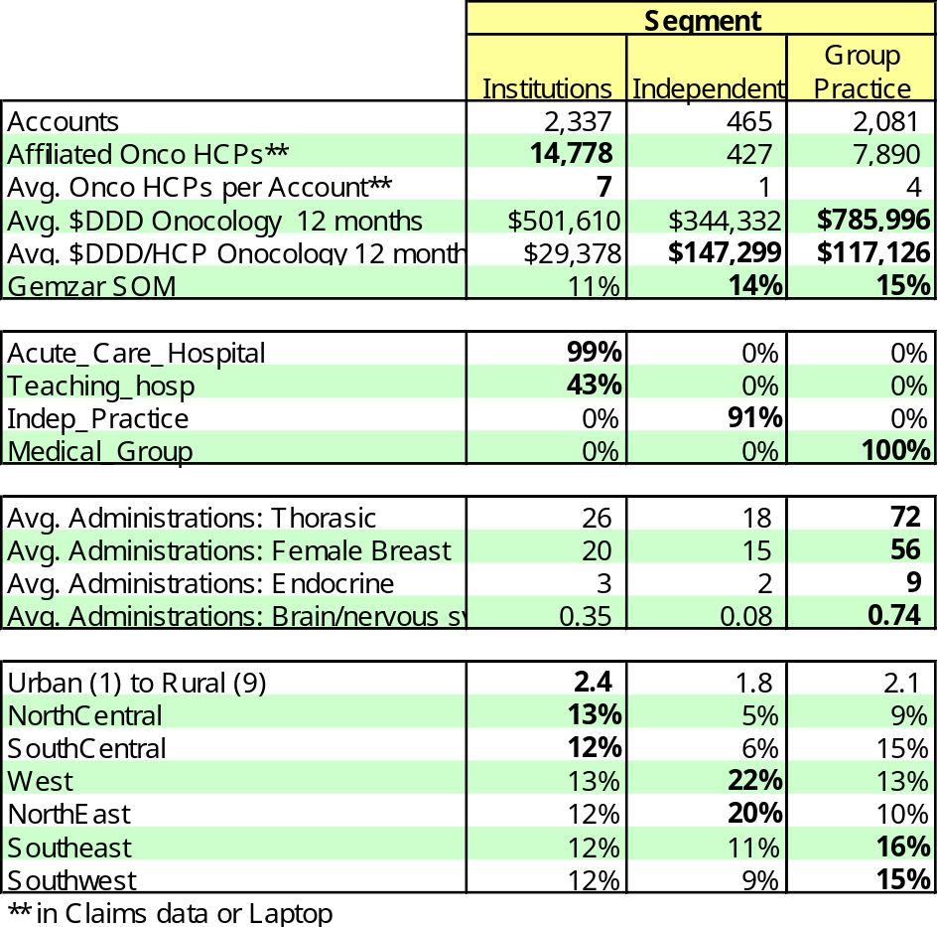
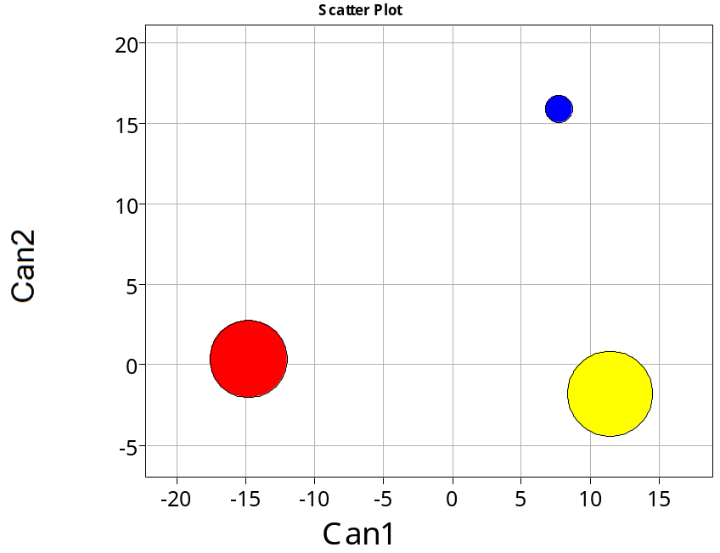
Account Segments
Independent
Group
Practice
Institutions
Sized by Accounts
Exclude Accounts with Volatile Sales?
Are there GPO/IDN dimensions that we should consider?
  ION
  US Oncology

Slide 12
Claims Projection
Four HCPs (A, B, C, D)
Claims Data, 90-100% of Volume
Claims Data, < 90% but sufficiently “stable” due to their switch volume and fidelity.
Some Claims Data, not “stable”
HCP in account, not in claims
A
A
Claims
Available
B
C
D
Claims
Available
Single Account
HCPs included in Claims data

Slide 13
Claims Projection and Imputation
Projection: the Basis for Response Modeling
Project to Doctor B: Scale volume across all products and months. Projections are based upon the practitioner sampling rate within the stratification variables of time, geography, and specialty designation.
Impute claims volume to Doctor’s C &D: Use Account and MD Segmentation to Assign Volume and Response rates based on MDs A & B above.
This segmentation will include tier, access, specialty, Account segment*. Total for MDs aligned to an account is scaled to the account.
*Use Tree Algorithm because Discriminate requires continuous input.
A
B
C
D
1
Claims
Available
Imputation: the basis of Revenue projections
A
B
B
C
D
2
Single Account
HCPs included in Claims data

Slide 14
DDD Spread
Use DDD to Allocate MDs to Accounts, then scale to claims-imputed volume across all products and months
Calibrate Response model on Doctor A and impute responsiveness to other MDs. for financial optimization based on segment.
A
B
C
D
Single Account
HCPs included in Claims data

Slide 15
The Key Role of Prescriber Segmentation
Segmentation
Universe
Financial Results
Claims Data
Response Model
50% of the MDs

Slide 16
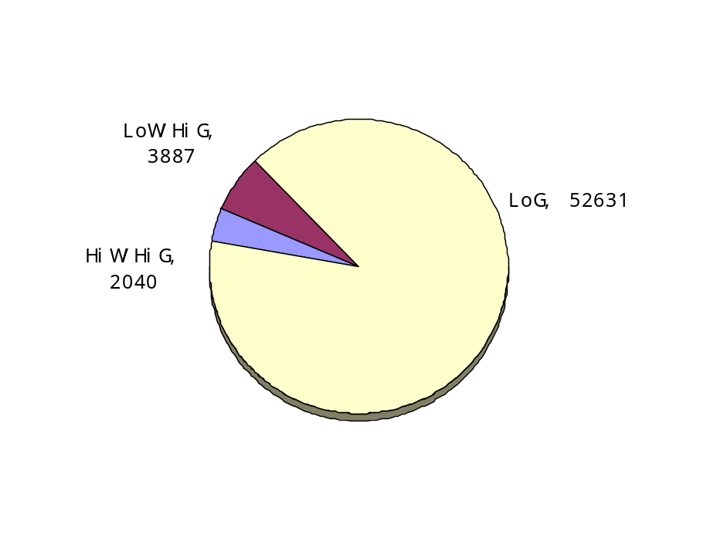
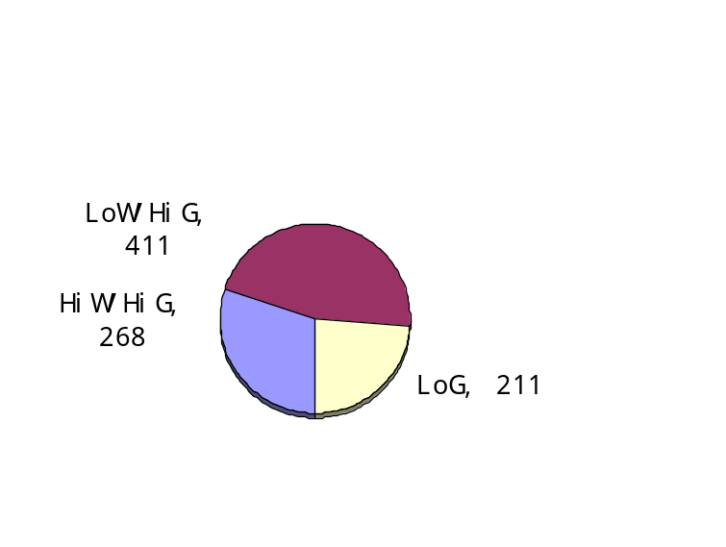
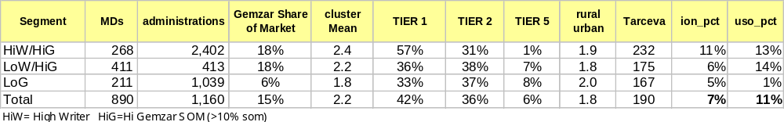
Prescriber Segmentation
Model
Onco Universe
Decision Tree Analysis: group MDs to predict administrations.
Segmentation: added Gemzar SOM (account-based) to Administration grouping +/- 10%.
Projection: project response scores to a much broader population than the 890 modeled MDs by focusing on account level data in the segmentation

Slide 17
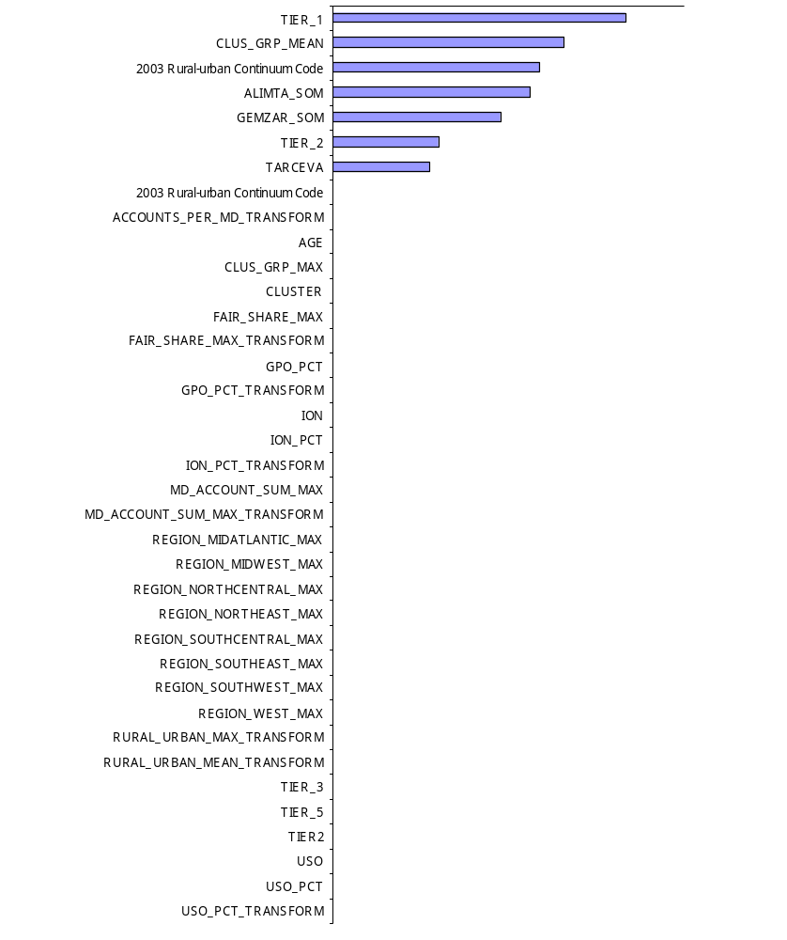
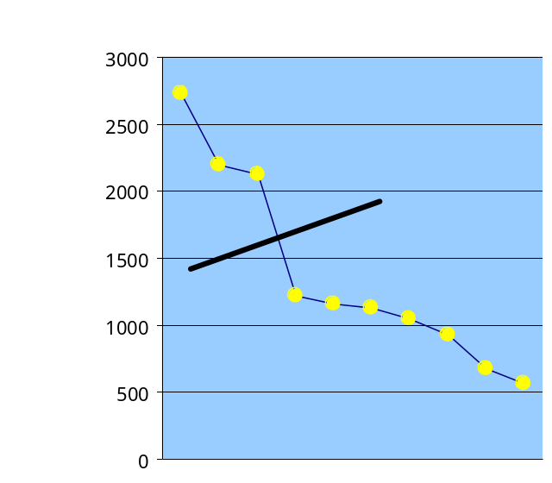
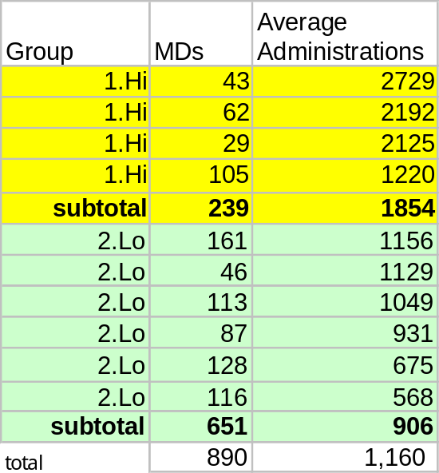
Prescriber Segmentation cont’d
Decision Tree Analysis used to group MDs based on administrations. Key variables included Sales Force tier, Account cluster average, Rural Urban code, Alimta and Gemzar Share, and utilization of Tarceva
Holdout Analysis indicated 62% proper group projection. (23% better than random)
Segmentation was completed by adding Gemzar SOM (account-based) to Administration grouping +/- 10%.
By focusing on account level data in the segmentation, we will be able to project response scores to a much broader population than the 890 modeled MDs

Slide 18
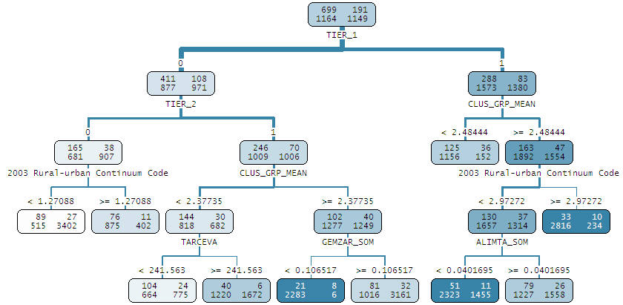
Decision Tree
Splits occur in the most efficient order of prediction (tier, Account Size, Acct. Cluster…)
Bottom tier of leaves used to create Physician segments
Provides non linear solution that finds “pockets” of MDs

Slide 19
HCP Flow
Model
Stable
Claims
Cluster
Projection
Affiliated
Laptop
Match CRD
All HCPs

Slide 20
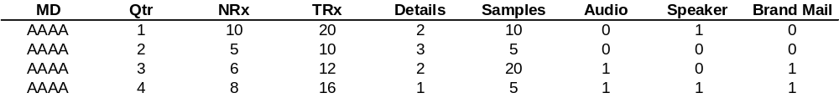
Promotional Mix Architecture
Conceptual illustration
Time series data on MDs
12 months of data for about 100,000 MDs
Response Models
Conceptually like regression but incorporates
  Correlations of MD behavior over time
  Takes into account MD prescription volatility
  Incorporates hierarchy in terms of MD segments
Widely used in Consumer packaged goods, Travel and Pharma industries
Optimization
Non-linear programming techniques used to make trade-offs across channels
x
x
x
x
x
x
x
x
x
Inc NRx
x
x
x
x
Inc $
x
x
Convert Inc NRx to Inc $ using refill, price
Convert activity to cost using cost per activity
x
Details
Details Cost ($)

Slide 21
Response Modeling Methodology
Response model estimates
  Incremental NRx due to MD level interventions
  Carryover of NRx that would occur without promotional effort
Mixed Models methodology is employed to estimate the response model
  Allows handling of correlation in MD behavior over time
  Allows variation in responsiveness of interventions by segment
    Segment definition is specific to the brand
    Segments could be based on brand team strategy, MD share behavior and attitude
  Possibility of estimating individual level responsiveness estimates while using information across the population (Bayesian shrinkage)
Optimization
  Nonlinear Programming is our primary tool -a classic technique for optimization
  Artificial Intelligence methods are used to handle more complex problems, such as cross-brand tradeoffs
  The idea is to recommend the optimal solution, not simply the first acceptable one

Slide 22
Promotion Mix Optimization
Goal: Optimally allocate resources across different physician groups and marketing channels to maximize profit while meeting operational and business constraints
Level of interventions
Decision variables
Response Models
  Incremental NRx
Price per TRx
Forecast
Refill
Margin
Inc Revenue
(3 yr)
Inc Cost
Maximize
Inc Revenue – Inc Cost
Non-linear optimization algorithm is used to optimize the level and mix of interventions
Objective

Slide 23
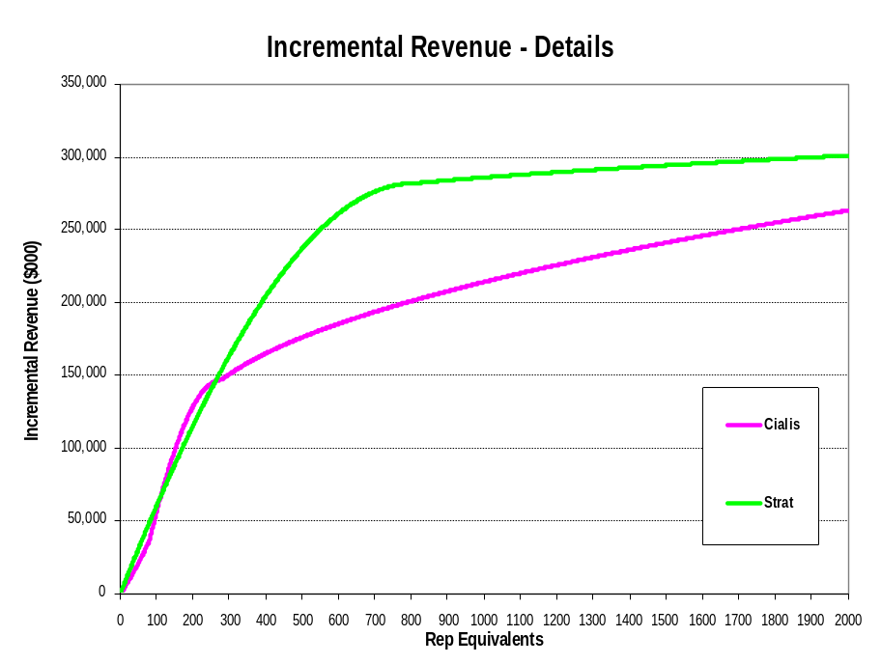
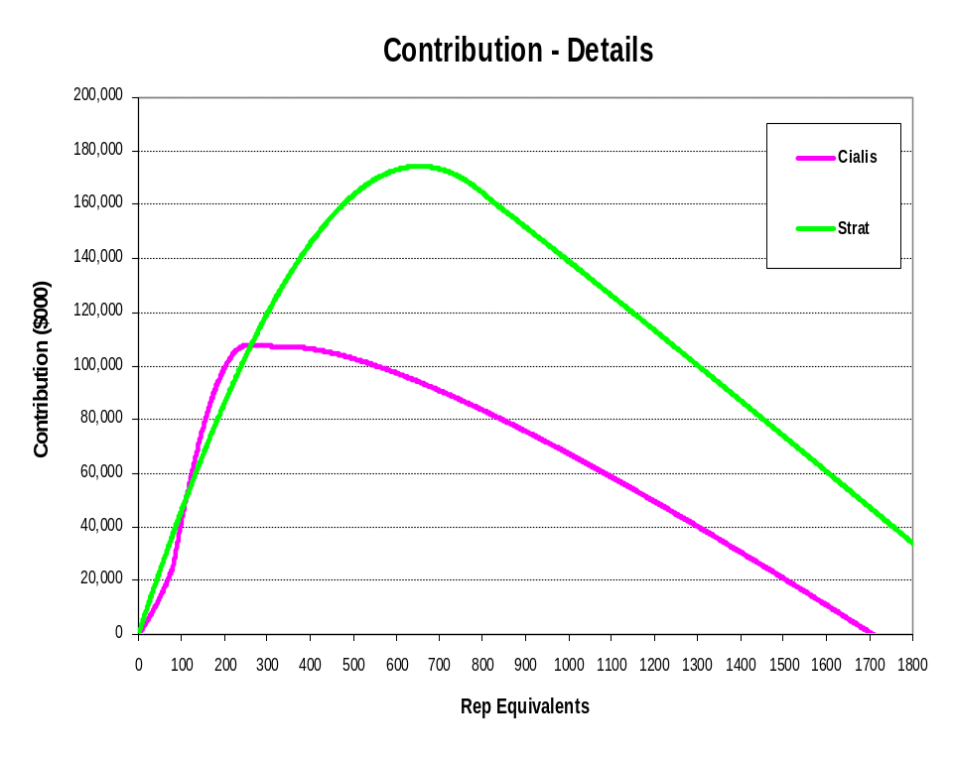
Response Model Output (Sales Force)
Contribution: One year of direct sales + two years of discounted carryover sales – one year of cost
Incremental Revenue: One year of direct sales + two years of discounted carryover sales

